Slide 1
Internet And Web Technology Lab IT-652
Anupam Chaudhary– 16IT8029
Sarvesh Bajaj – 16IT8035
Soham Mehrotra – 16IT8037
Date: 22.01.18

Slide 2
Project
Student Information System
A set of student friendly web pages that allows students to maintain their records which can be governed by one or more administrators.
Date: 22.01.18

Slide 3
Tools
HTML
CSS
Python
MySQL
JavaScript
Date: 22.01.18

Slide 4
Web Pages
Home Page
Contains the Register/Login Link for students/admin
Contains general notice and information, will be a static page.
Date: 22.01.18

Slide 5
Web Pages(contd..)
Registration
The User details will be redirected to the Admin Dashboard from the Registration page.
A checkbox will be kept for request for admin status.
Date: 22.01.18

Slide 6
Web Pages(contd..)
Login
The User Credentials will be checked from the Database which will contain a field for Role of the User. Accordingly, the User will be redirected.
Students will be redirected to the Home Page with a logged in indication.
Admin will be redirected to Admin Dashboard.
Date: 22.01.18

Slide 7
Web Pages(contd..)
Admin Dashboard -- I
All details of registration requests will be shown here. Upon approval, it will be added to the database with a proper role.
All User details from the database will be listed here along with a search option
Date: 22.01.18

Slide 8
Web Pages(contd..)
Admin Dashboard -- II
All Create and Update Functionality of Users will be available here.
The option to Delete the User will also be given.
Date: 22.01.18

Slide 9
Web Pages(contd..)
Student Dashboard
After Logging in as a student, the User will be redirected to the home page and the Register/Login link will be replaced by a logged in icon.
Date: 22.01.18

Slide 10
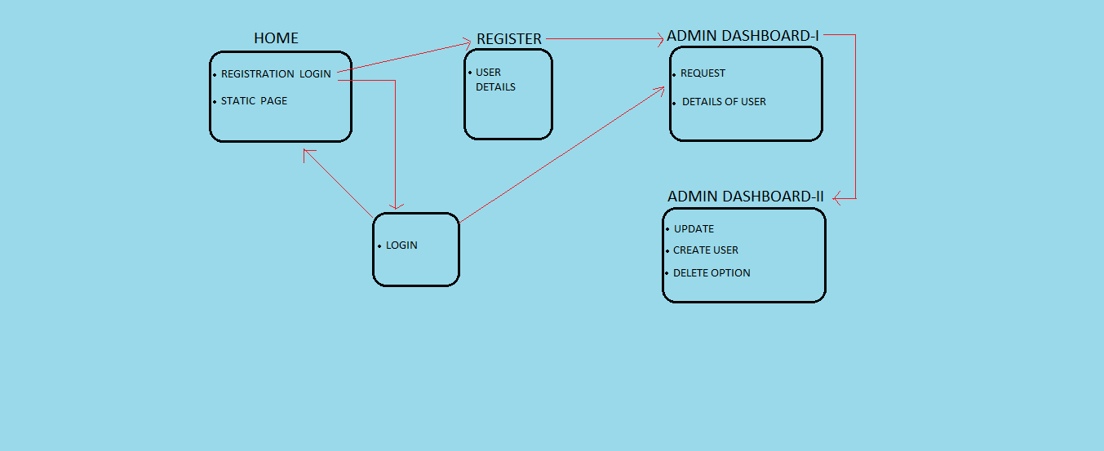
Workflow
Date: 29.01.18

Slide 11
Work Division
Frontend – Home Page
Tried by all for exposure to HTML and CSS, but the best one chosen.
Presentation
Sarvesh and Soham
Flowchart
Anupam
Date: 29.01.18

Slide 12
Next Week Plans
Frontend
Registration Page will be designed.
Backend
Designing the Database Schema and presenting the ER Diagram.
Date: 29.01.18

Slide 13
Work Done (Date-wise)
29.01.18 -> Home Page Created
06.02.18 -> Registration Page Created, Database Schema Finalized
Date: 06.02.18

Slide 14
Work Division
Frontend
Home Page – Done by all, chosen one
Registration Page – Soham
Backend
Database Schema – Sarvesh
Date: 06.02.18

Slide 15
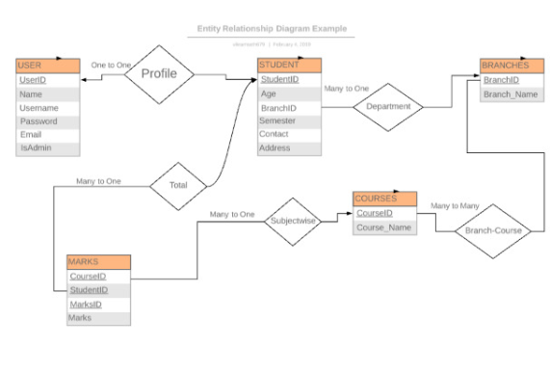
ER Diagram
Date: 06.02.18

Slide 16
Elements – Registration Page
Input
Text
Password
Submit
Checkbox
Select
Text-Area
Button
Date: 06.02.18

Slide 17
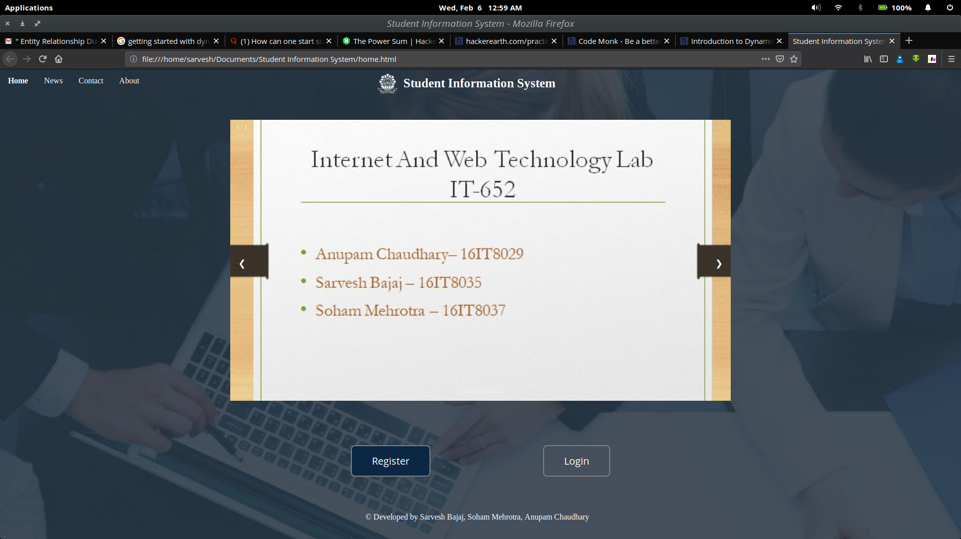
Home
Date: 06.02.18

Slide 18
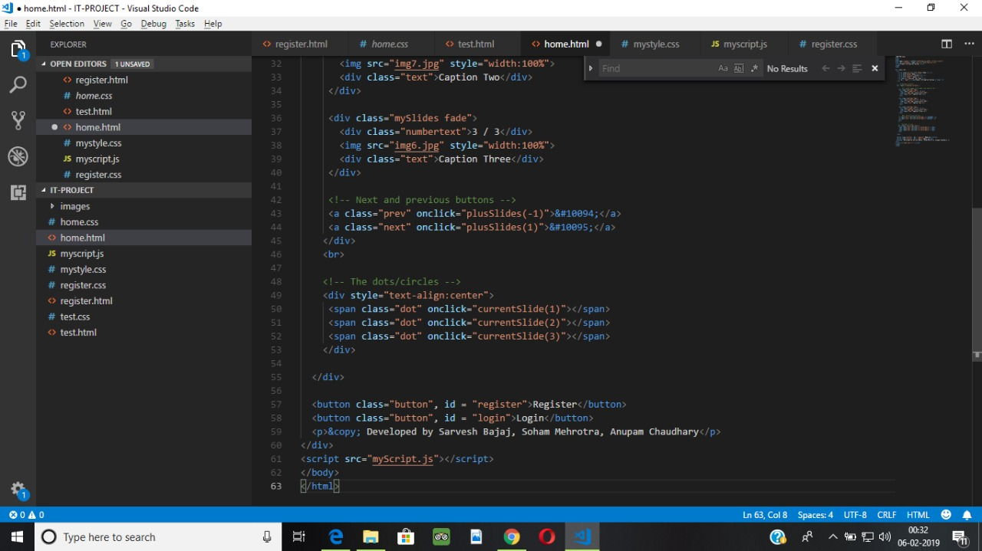
Home HTML
Date: 06.02.18

Slide 19
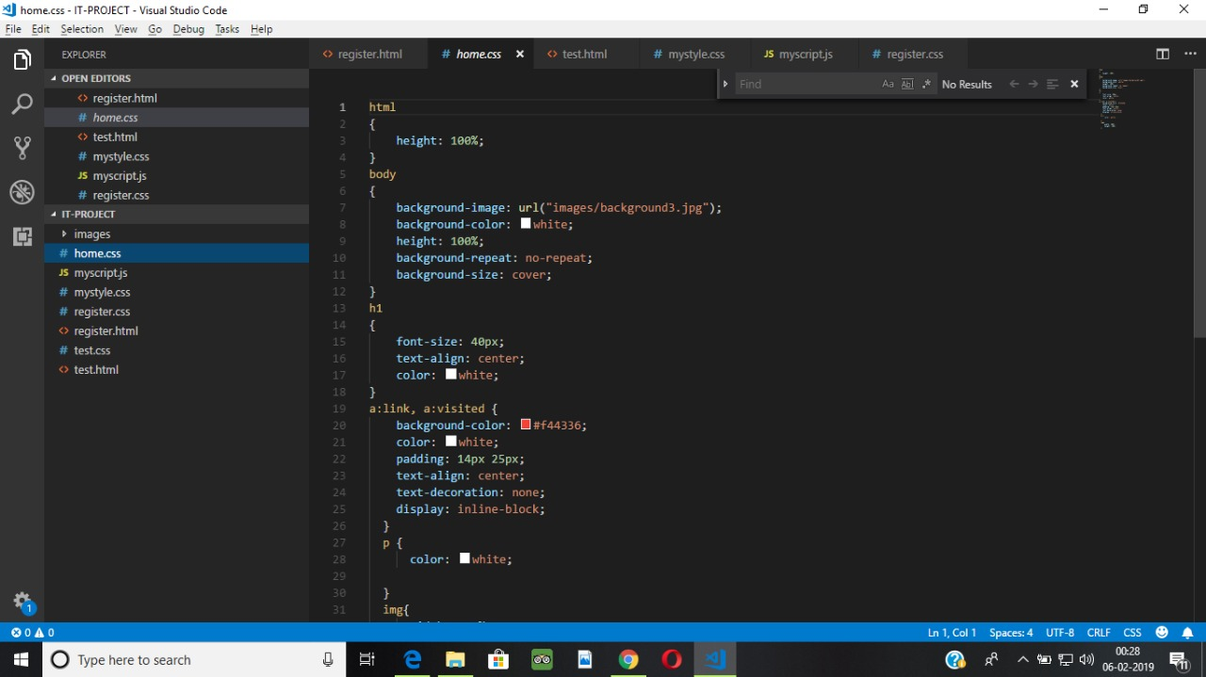
Home CSS
Date: 06.02.18

Slide 20
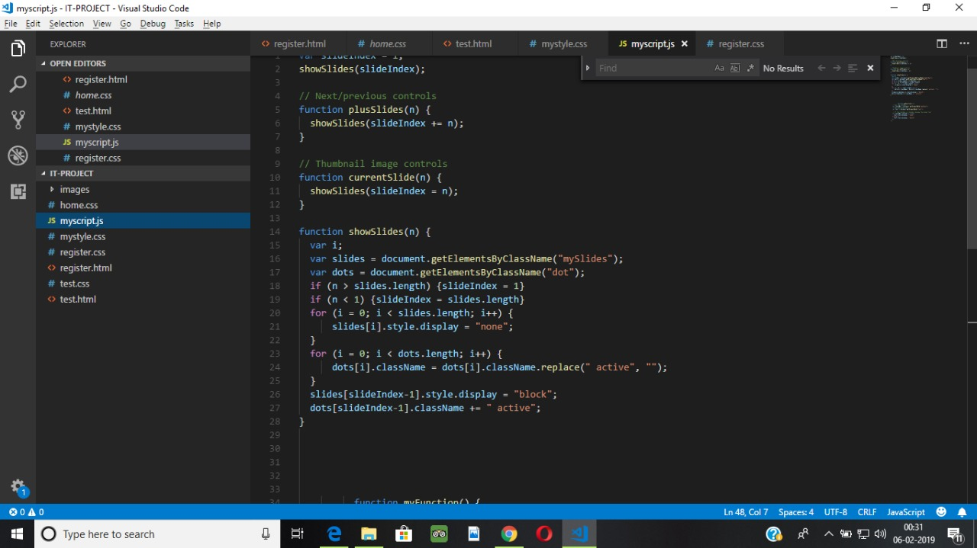
Home JS
Date: 06.02.18

Slide 21
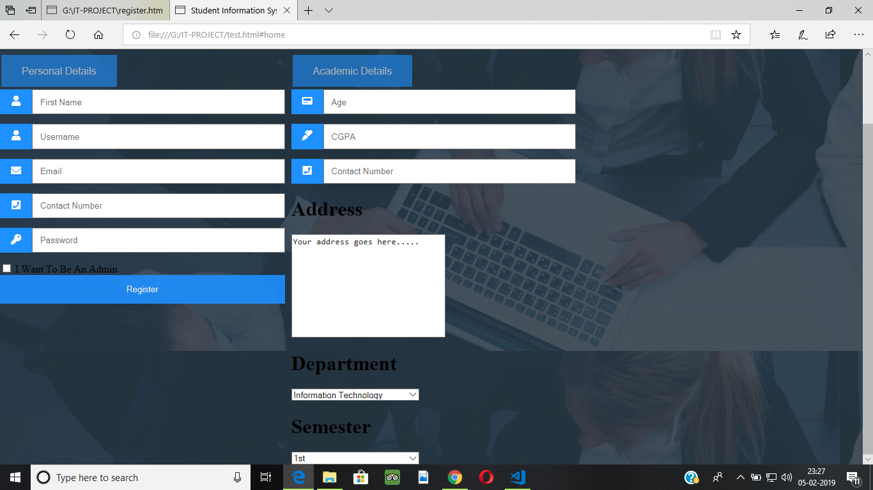
Registration (Student)
Date: 06.02.18

Slide 22
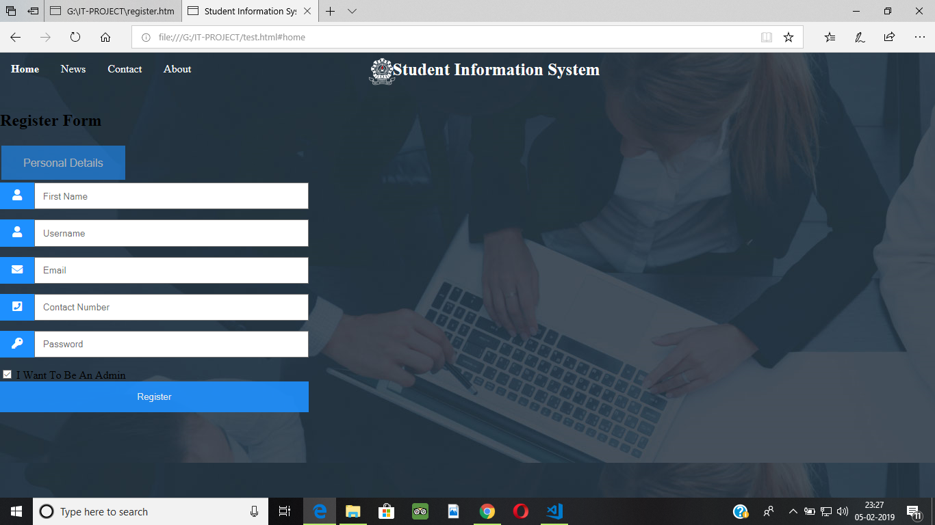
Registration (Admin)
Date: 06.02.18

Slide 23
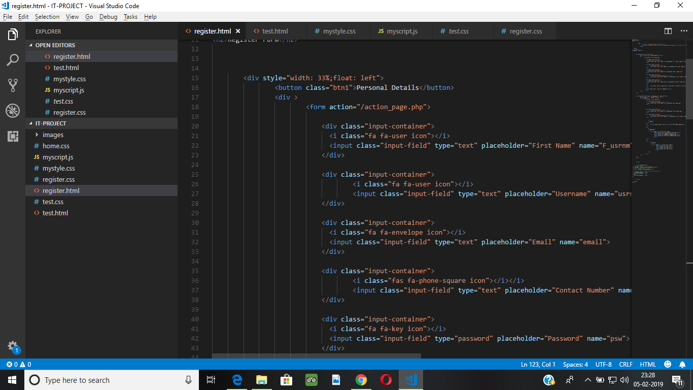
Registration HTML
Date: 06.02.18

Slide 24
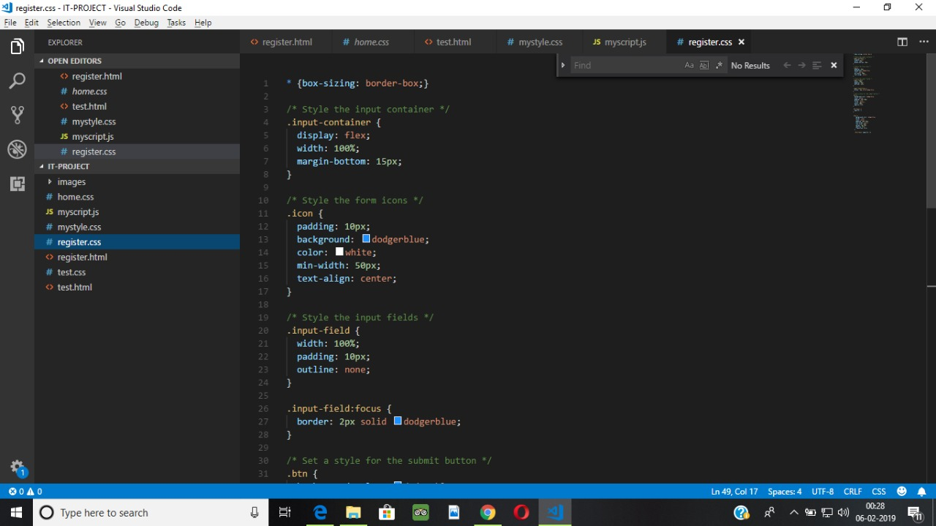
Registration CSS
Date: 06.02.18

Slide 25
Next Week Plans
Admin Dashboard – I and II will be designed.
Form Validation
Date: 06.02.18

Slide 26
References
Frontend
w3schools.com
Backend
Microsoft MySQL Docs
Tutorials Point
Date: 06.02.18

Slide 27
THANK YOU!

